Slide 1
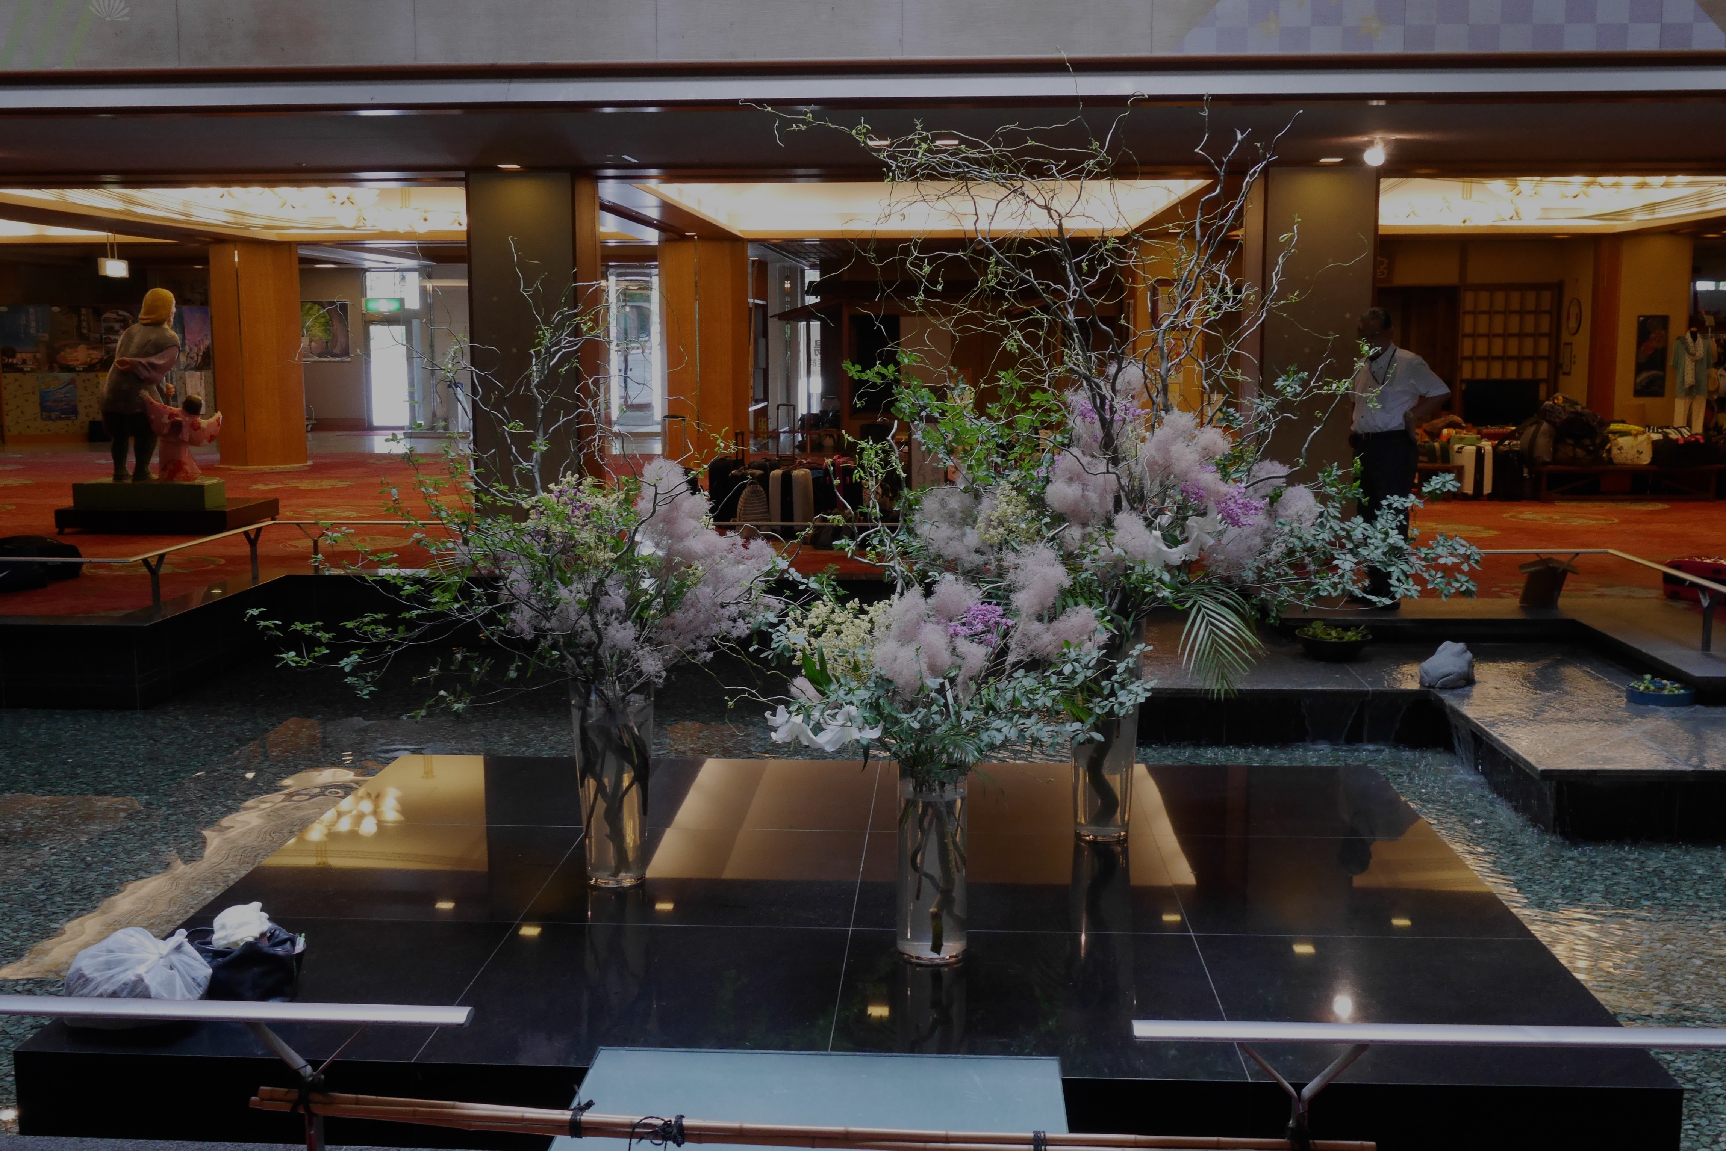
High-Throughput Cognitive and Affective Assessment (at a Japanese Hot Springs Resort)
Dav (デイヴ) Clark

Slide 2
Education is Hard
Consider: the whole-word and phonics approaches to teaching reading were both present by ~0 CE
We still haven’t agreed about how to teach reading (at least as of 2010)
My read is that evidence clearly supports the necessity of phonics
Scientific evidence is not enough to shift social-cultural systems
What if scientist-teachers could see results themselves?

Slide 3
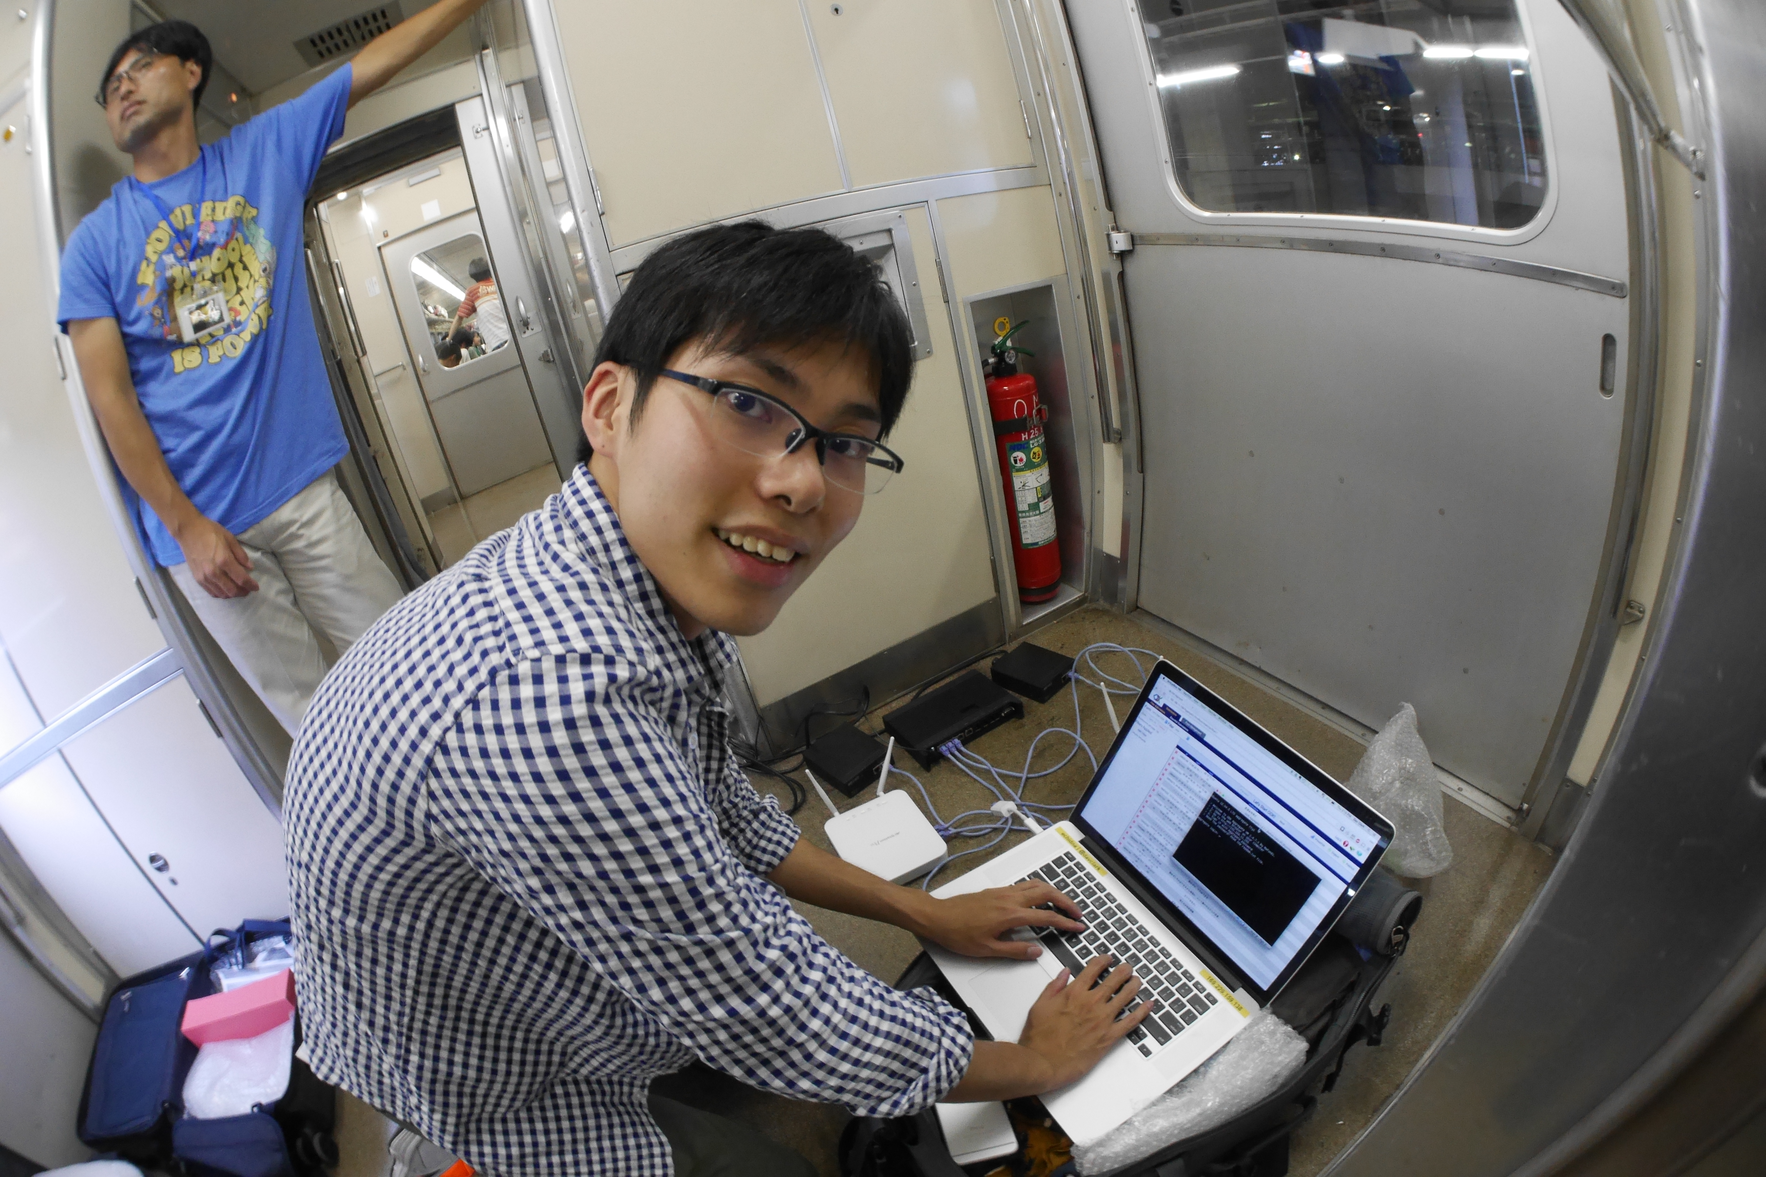

Slide 4
Working with SHO Zemi
Japanese educators have a documented high willingness to observe and reflect on teaching (Building a Better Teacher, Green)
SHO Zemi has ~26,000 students across 200 sites, MOOC-like scale with physical access
We started with a summer program that brings ~600 kids to one place
Emotional assessments using VAS
Cognitive assessments with Lumosity

Slide 5
Students are different too…
We worked with a class of 40 students in a “homeroom”
Each day, students take a simulated test and are assigned to a level-appropriate classroom
We tested the kids 4 times a day, with the restriction that we had only 5 minutes for each session
Only one student had missing data for one day

Slide 6
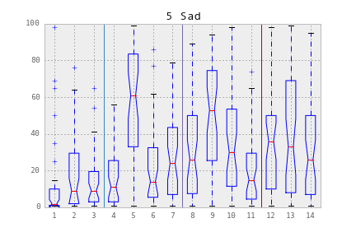
We see huge variations in reported emotion

Slide 7
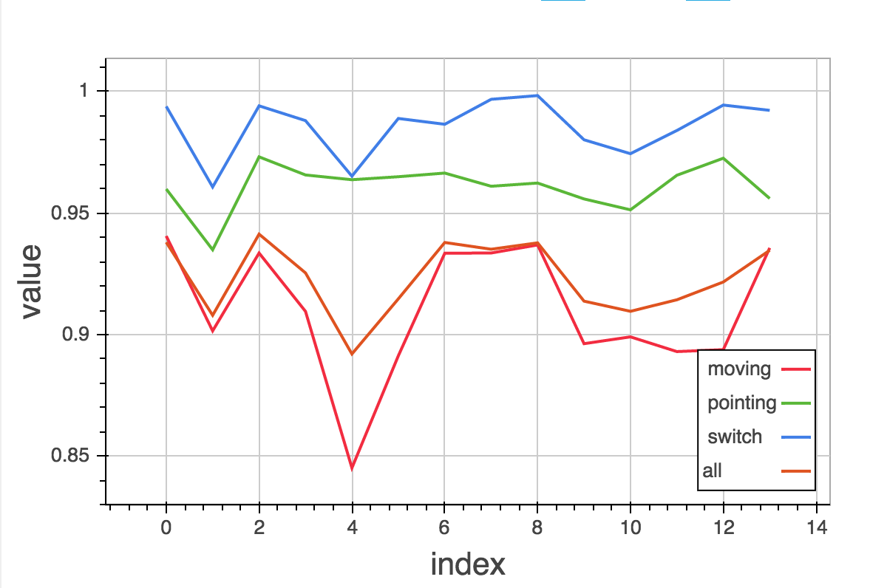
Which apparently coordinates with “cognitive” threshold-setting

Slide 8
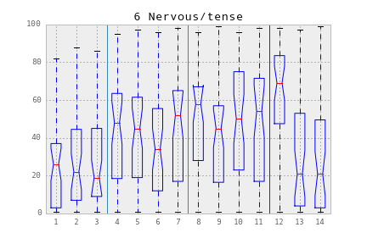
Teachers report mis-reading student anxiety

Slide 9
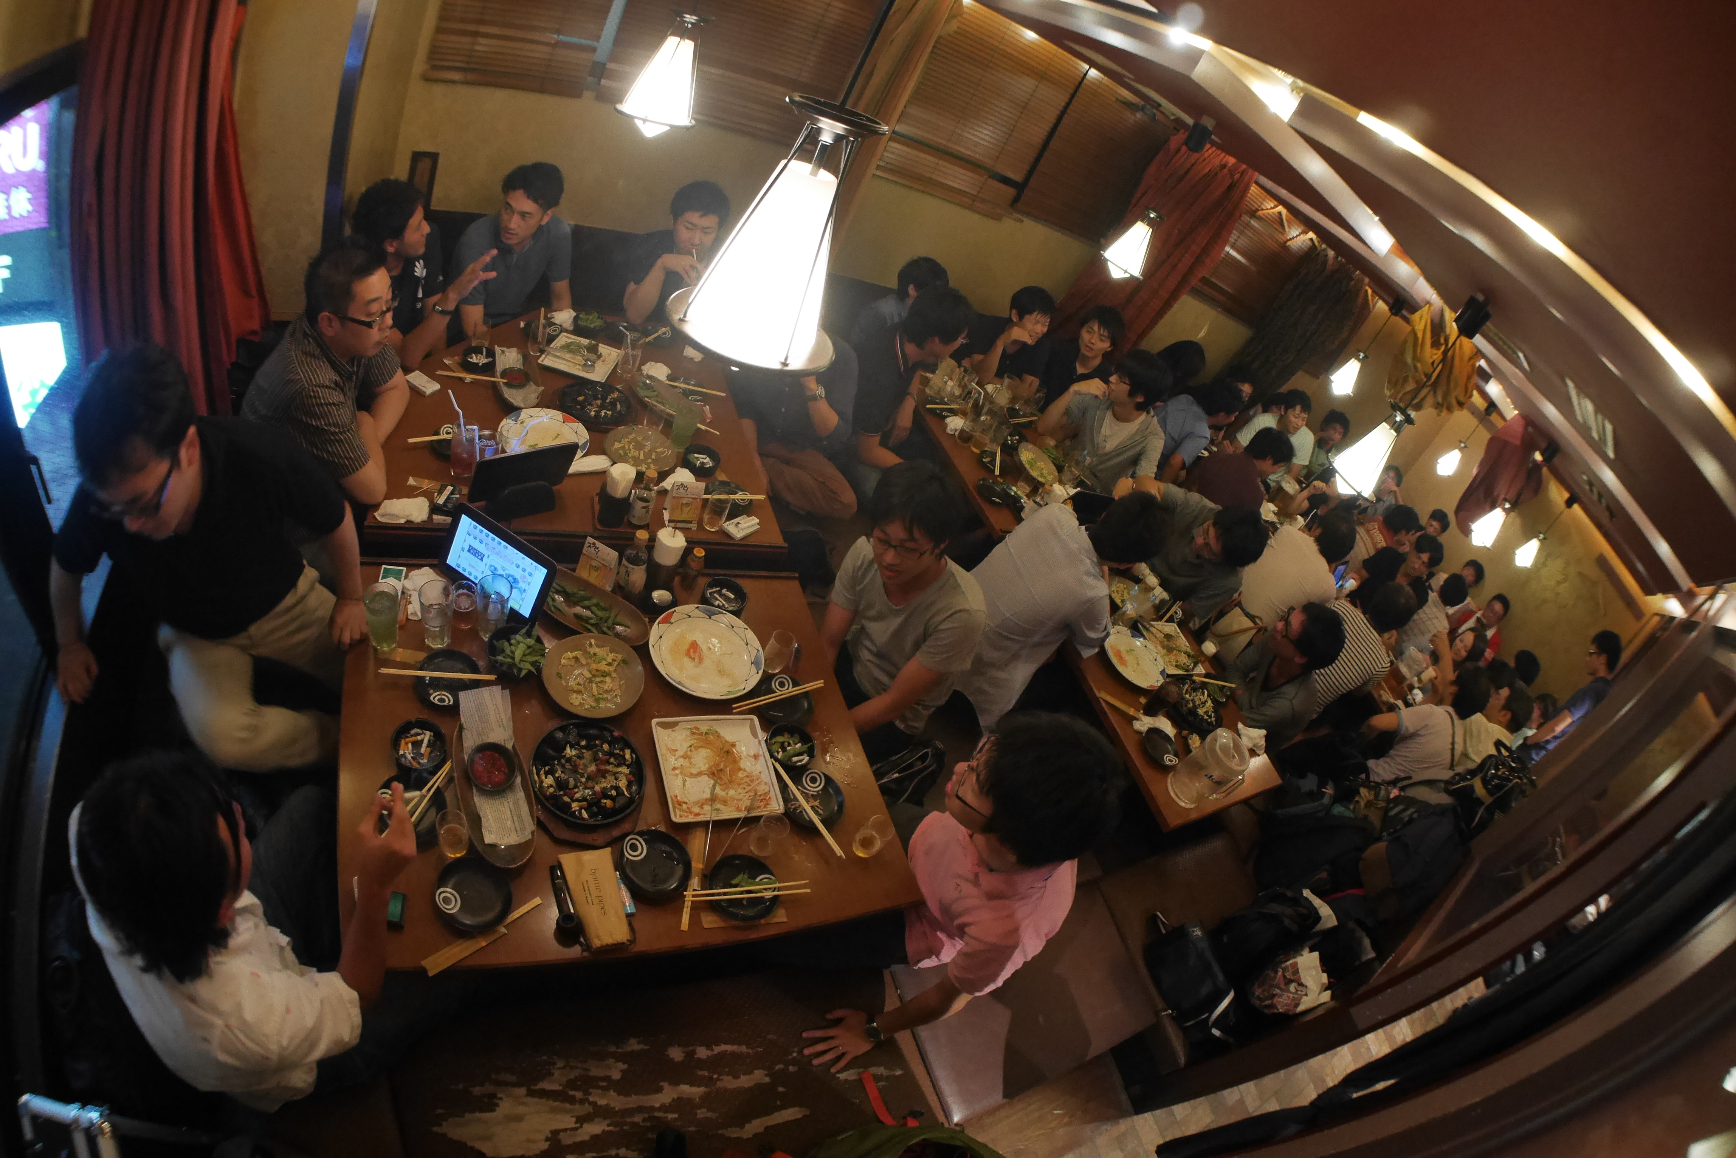
Teachers are excited!

Slide 10
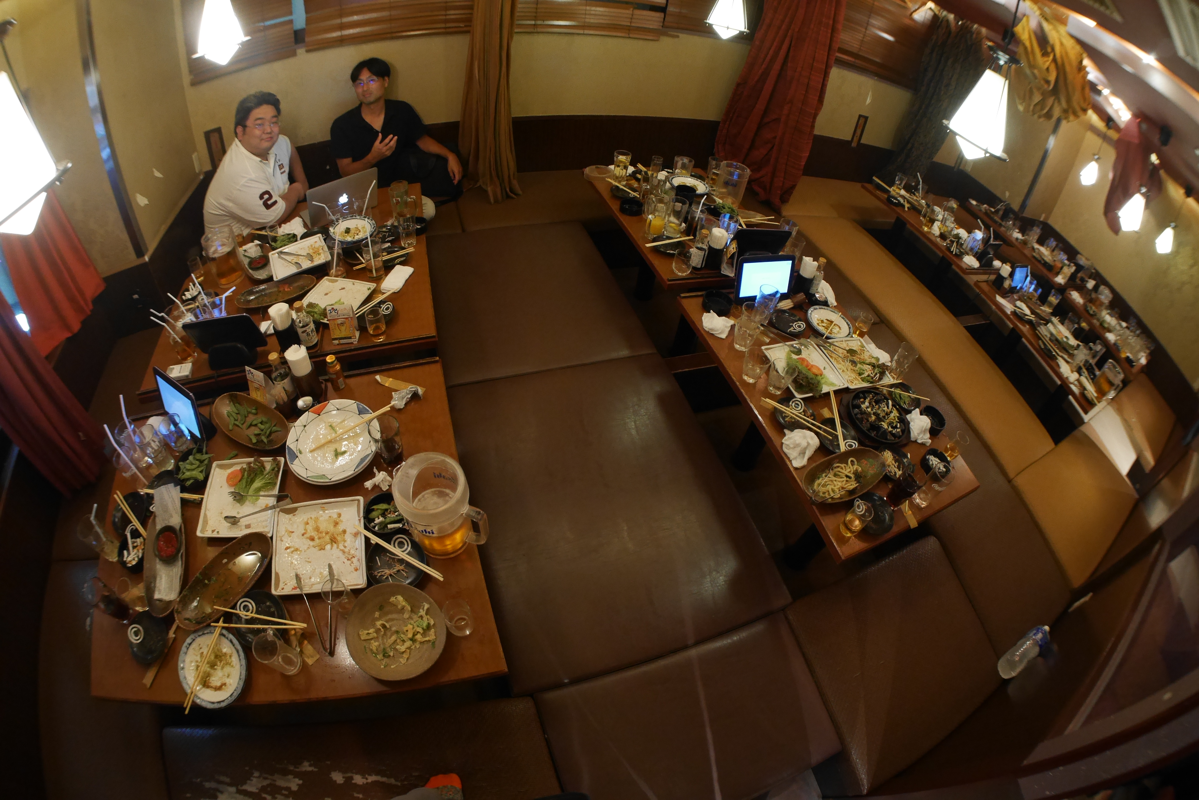
Shutting down the party…
with some science

